Slide 1
Arduino Music Player
Embedded Systems Final Project

Slide 2




Introduction
Jasindan Rasalingam
Kaushal Patel
Darron Singh
Ashwin Kamalakannan

Slide 3
Project Overview
Objective
Create a music player using an arduino and LM386 signal amplifier, and potentially add an alarm feature with display
Relation to Embedded Systems
Micro-controller
System has a dedicated function, that is part of a larger system
In this case the speaker and arduino are part of the alarm clock
Digital to Analog signal conversion
Designed for a specific purpose, play audio files (.WAV)

Slide 4
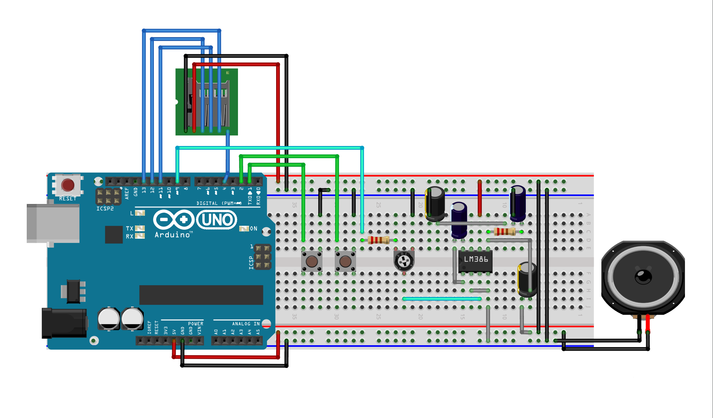
Schematic
Components
Arduino
SD Card Reader
LM386 Amplifier
10uf cap x2, 100uf cap x2
1K res, 10K res
Push button x2

Slide 5
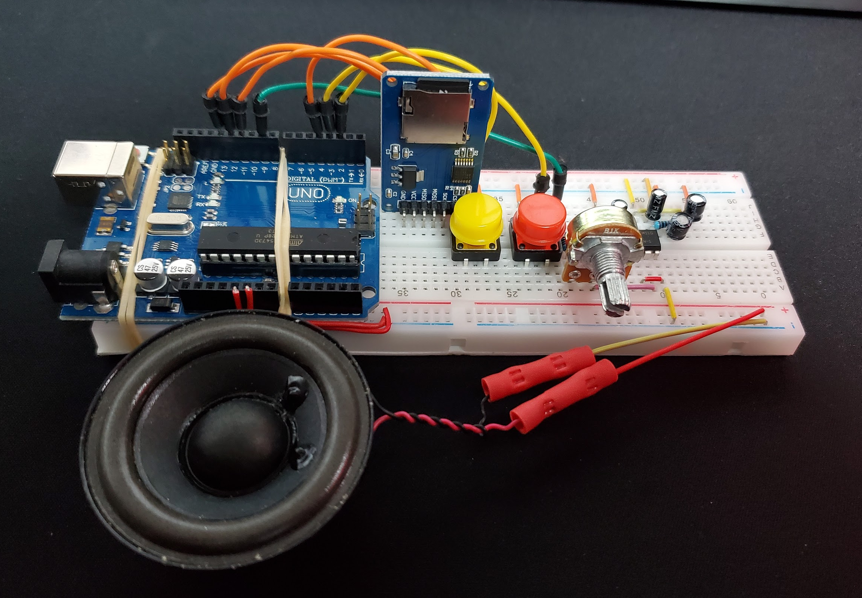
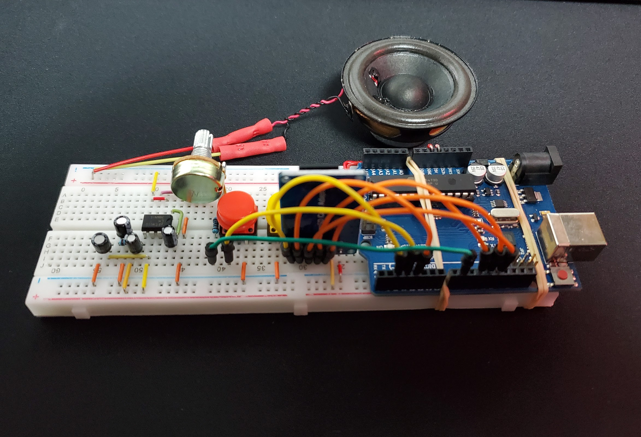
Implementation
View 1
View 2

Slide 6
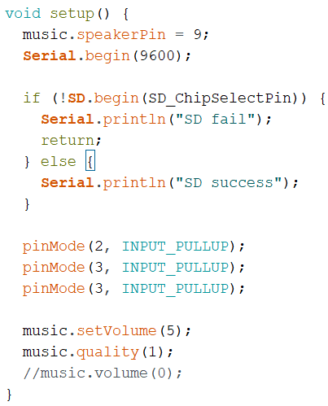
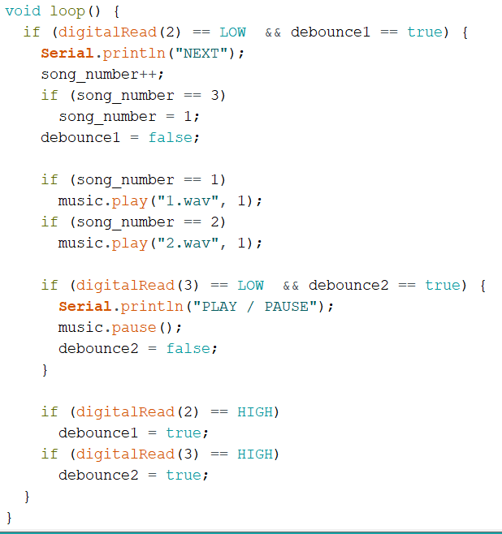
Implementation (cont’d)
Set pin for speaker output and SD card
Set pins for push button input
Configure music player
Read next button and switch tracks when pressed
Read pause button and pause when pressed
Basic debounce so we don’t capture multiple inputs
TMRpcm library for async music playback
Setup
Loop

